Slide 1
GDS-LDSS CA 1 Presentation 2017 ASTRO DEFENDER
Chen Yu p1626063

Slide 2
Game Overview
Genre: Top-down shooter, survival
Game setting: Player is trapped in a remote refinery planet invaded by alien droids, he has to establish contact with the headquarters to call for further support. This is done by reaching the satellite dish in the edge of the map.
Main controls: Right click to move, left click to shoot, R to reload
Other controls: Mouse wheel scroll to zoom, N to reset zoom. P or ESC to pause/resume.

Slide 3
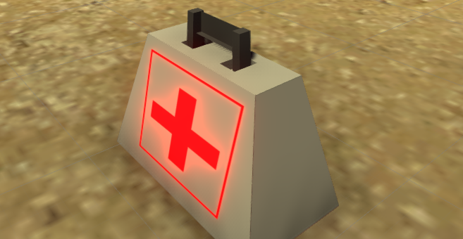
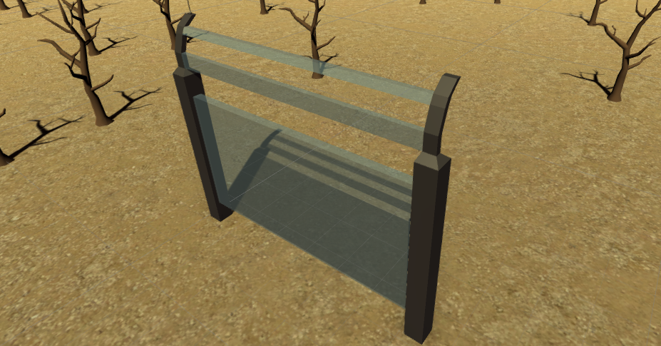
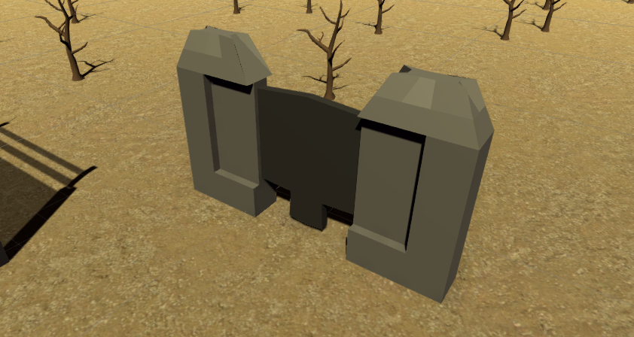
Models - Simple
First Aid
Space Fence
Space Gate
Pick up

Slide 4
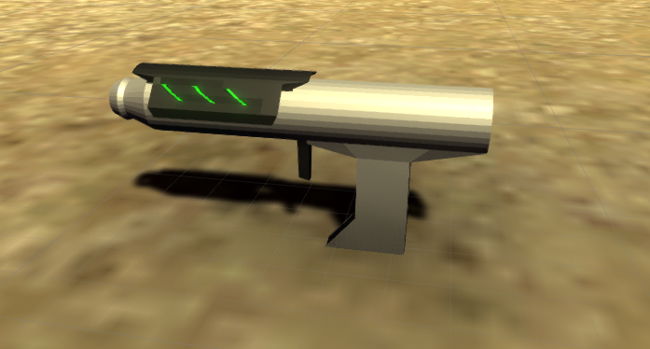
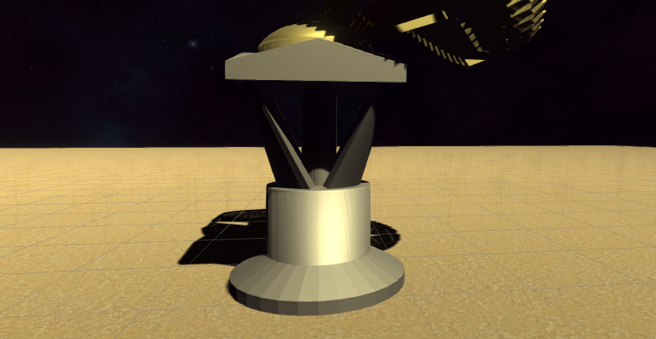
Models - Simple
Space Gun
Satellite Dish Stand

Slide 5
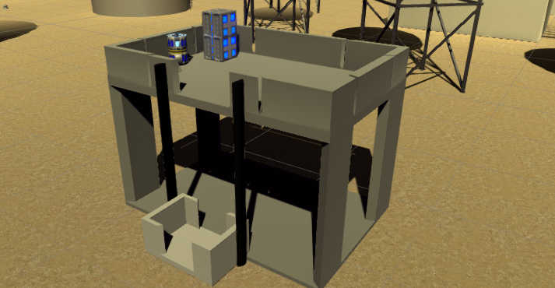
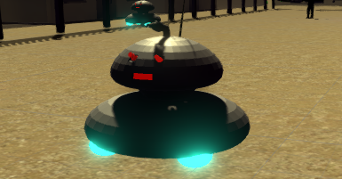
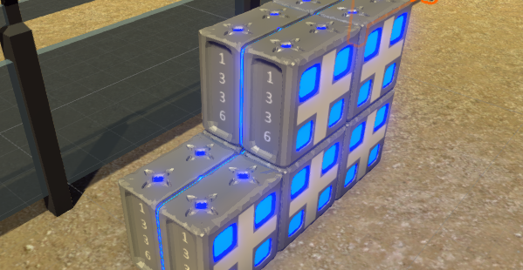
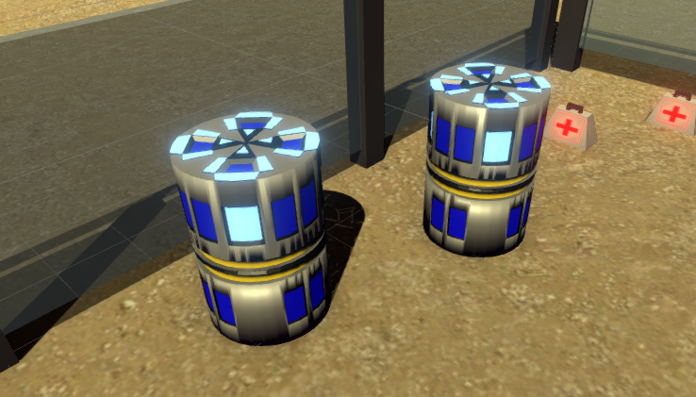
Models - Medium
Platform
Space Droid
Crates
Barrels

Slide 6
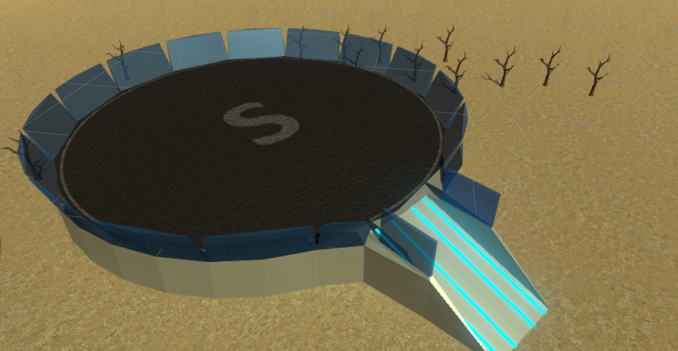
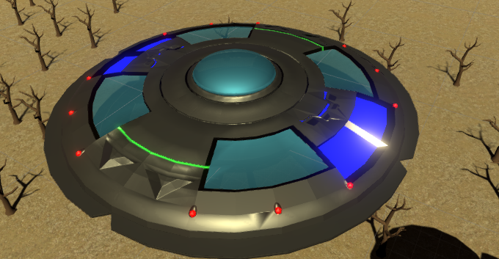
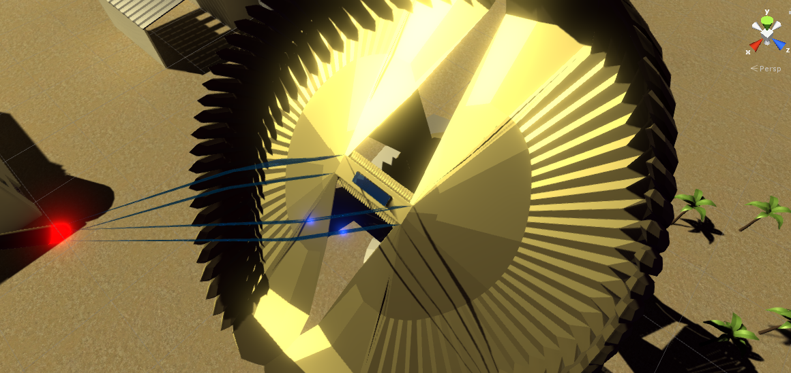
Models - Advanced
Space Craft Pad
UFO
Satellite Dish

Slide 7
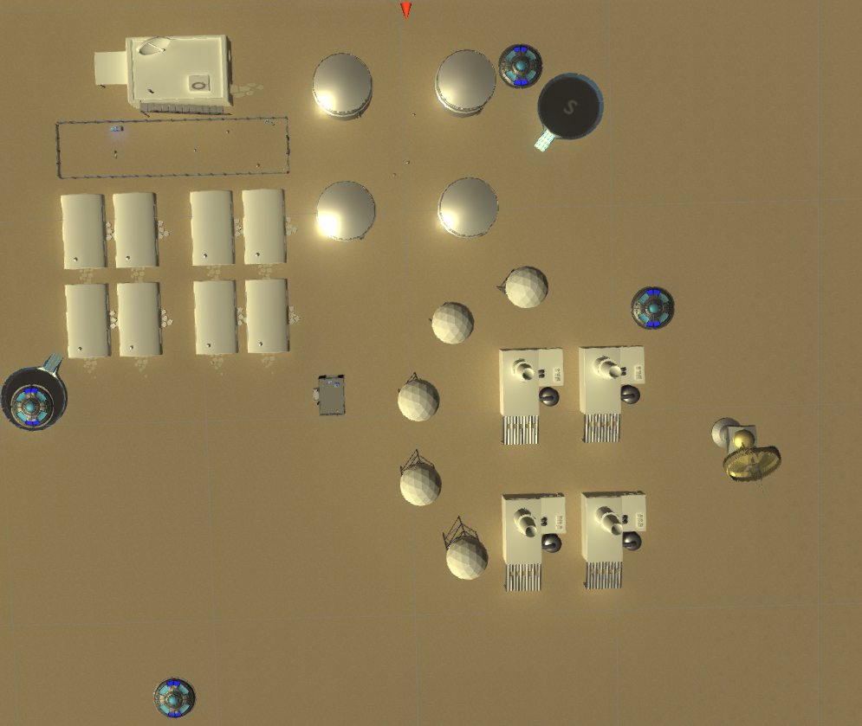
Level Design – Map Regions
- Spawn Points
Gate
Region 1
Start Area
Region 2
Region 4
Lift
Objective
Region 3

Slide 8
Level Design - Routes
Will face a lot of enemy at one shot, but faster reaching objective
Fight the enemies at a slower pace with pick up are the top of lift, all droids will retreat if the player has destroyed 150 of them, and safely proceed to the object

Slide 9
AI States
Patrol, Engage, Search, Idle, Retreat
Patrol will move around the way point targets and will alert by presence of player if the player is too close or getting shot from any distance. If the alert is being shot, all droids in the spawn region will engage the player.
After being alert will go engage, which is shooting and chasing the player up to a distance.
In engage, if the player is too far or out of sight, it will keep chasing the player but with no shooting, and also start counting out of range sight, after out range reached around 5 sec, will switch to search
Search will take the last known player position and randomize for 5 different search points, if player is in sight again, will switch to engage.
After all search points if player is not found, it will go into idle for 3 sec then back to patrol.

